Slide 1

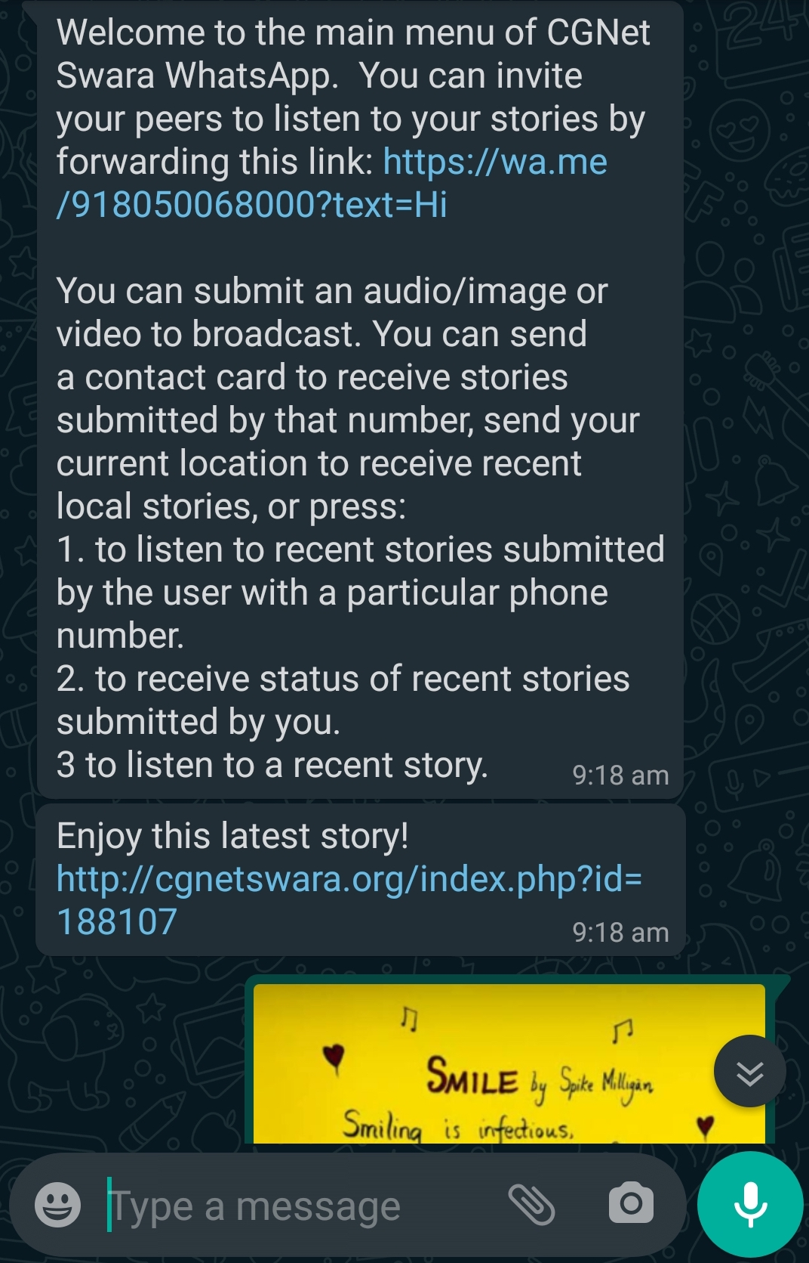
Demo: A WhatsApp Bot for Citizen Journalism in Rural India
Introduction
Complements IVR systems
Functionalities
Receive audio, video and image stories
Send location, phone number based recent stories
WhatsApp preferred over App
Update of recent stories
Results for 7 weeks:
396 stories received, 140 published from 30 unique users
Priyanka Verma [BITS Pilani, India, vpriyanka0492@gmail.com], Ananya Saxena [IIIT-Naya Raipur], Alok Sharma [DN Developers], William Thies [Microsoft Research], Devansh Mehta [Voicedeck Technologies]

